Slide 1
Welcome to Oak Class
Teacher - Mrs Stoner
Teaching Assistant - Ms Lyle

Slide 2
Accelerated Reader
Computer based programme which assesses children’s levels in reading
Children read books of suitable ability and interest within their level
Once the book is read, children will complete a quiz on that specific book
Experts state that children who read at least 20 minutes per day and have a 90% comprehension rate (on their quizzes), will make accelerated progress in reading
The more that children read, the more progress they will make, therefore children will still be expected to read every evening

Slide 3
Accelerated Reader (AR)
Bookworm Race -
100% Raffle Tickets – KS2 – termly prize
Number of words awards – KS2

Slide 4
English expectations

Slide 5
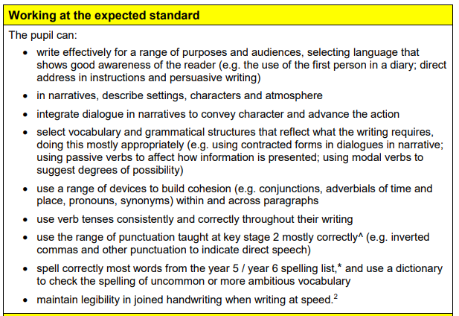
English expectations

Slide 6
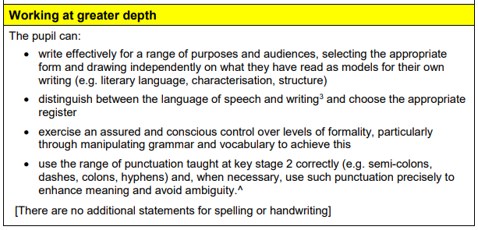
English expectations

Slide 7
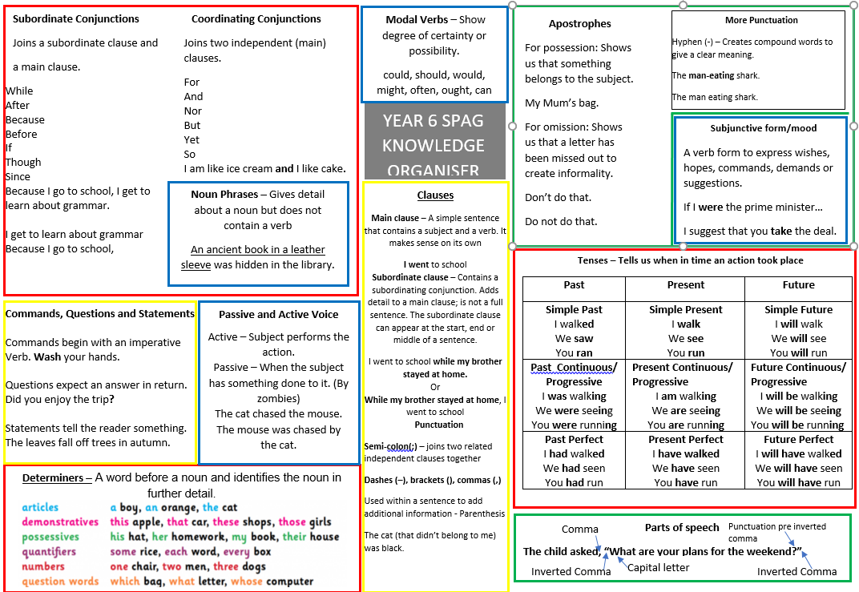
Grammar Mat

Slide 8
Maths Knowledge
Year 4 12 x12
Your Child’s Revision Guide

Slide 9
Maths Expectations T:\Classes\2015 +\Oak\numeracy\resources - maths\Your child's maths revision guide.docx
Year 5 I can statements
T:\Curriculum\Maths\End of Year expectations\Year 5 maths.docx
Year 6 will be taught…
T:\Curriculum\Maths\End of Year expectations\year 6 maths.docx

Slide 10
Maths Mat

Slide 11
Homework Expectations Not optional
There will be no spelling homework this year
Reading Homework – Children are expected to read for a minimum of 10 minutes a night. – Optimum reading time would be around 20 minutes reading and discussing book with an adult.
We are using a new spelling scheme, so there will not currently be set activities to complete each night, but we will be sending a sample of the spelling words home that fit a spelling pattern/rule. The children should not just be learning these words, but actually learning the rules and the exceptions.
There will also be some grammar questions (SATs style) for the children to complete.
T:\Curriculum\English\Reading\Questions to ask your children when they read with you.docx
Maths Homework
This will be based on the number facts and maths knowledge that is essential to support the strategies and methods that are taught in school.
There will also be topic homework, which will be due in every 2 weeks.

Slide 12
Behaviour Expectations
Uniform inc earrings etc.
P.E. kit
Behaviour before and after school
Role models
Respect for each other and property – legal responsibility

Slide 13
Attendance Including arriving to school on time
Attending every day matters!
There is a very clear link between attending in all year groups and achieving well in school. In fact, sustaining 96% attendance means a pupil is more likely to reach the expected standard in both English and Maths than a pupil who is at 90%

Slide 14
Requests for absence in learning time
The Education (Pupil Registration) (England) Regulations 2013 only permit headteachers to authorise absence where exceptional circumstances apply. The guidance for headteachers explains that ‘exceptional’ is likely to be rare, significant, unavoidable and short.

Slide 15
Pencil Cases and Rucksacks

Slide 16
St John’s Website
St. Johns Baptist Primary School - St Johns Baptist Primary School
And newsletters

Slide 17
Any Questions

