Slide 1
Welcome Meeting Years 4&5 Holly class Wednesday 19th July 2023

Slide 2
Welcome to Holly Class
Class Teacher – Mrs Wellby
Teaching Assistant – Mrs Sheikh, Ms Lyle
The children will also be taught by Miss Filfil on a Monday morning and all day Friday
Notes:
Corrine

Slide 3
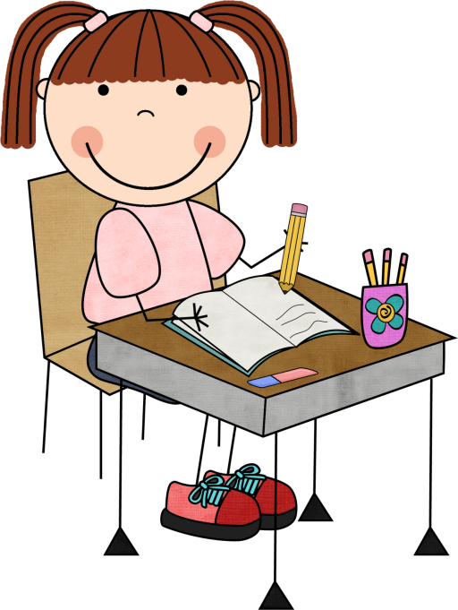
English
English teaching encompasses:
Shared Reading
Writing
Handwriting
Spelling
Grammar and Punctuation
Notes:
Ceri

Slide 4
Reading
Star Assessment – assesses children’s levels in reading
Children read books of suitable ability and interest
Once the book is read, children will complete a quiz on that specific book
Experts state that children who read at least 20 minutes per day and have a 90% comprehension rate (on their quizzes), will make accelerated progress in reading
The more that children read, the more progress they will make

Slide 5
English
We will be using ‘The Literacy Tree’ to support us in our teaching of writing, including grammar and punctuation.
This will ensure that we have good quality texts throughout the years and that targeted grammar and punctuation expectations are always taught within English lessons, not just as discrete subjects.

Slide 6
Spelling
‘No Nonsense’ spelling will be being taught three days a week.
Children will be split in to year groups to ensure they are taught their own, targeted spelling patterns.
Year 3 will be taught by Mrs. Griffiths.
Year 4 will be taught by Ms. Lyle.
Year 5 will be taught by Mrs. Wellby.
Year 6 will be taught by Mrs. Stoner.

Slide 7
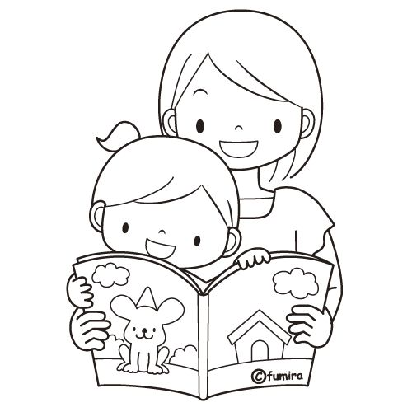
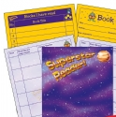
Reading Records
Please read with your child as often as you can.
Reading Records - please sign once a week for your child to hand in every Monday morning
Notes:
Ceri

Slide 8
Maths
A new Maths scheme, from the NCETM (National Centre for Excellence in the Teaching of Mathematics) is being used next year.
This focuses on fluency and understanding of mathematical facts before moving on to deeper thinking and reasoning.
This should give all of our children a strong mathematical knowledge and support them throughout their primary education.

Slide 9
Maths
In the Autumn term, we will be trialing a new approach to our Maths teaching, splitting the children into year groups, rather than classes. This will provide:
A dedicated focus on each year group’s objectives.
Targeted support.
Smaller class sizes.
Mrs. Griffiths will be teaching Year 3.
Mrs. Wellby will be teaching Year 4.
Mrs. Sharrock will be teaching Year 5 Maths four days a week, with the fifth day being a consolidation day, taught by an HLTA.
Mrs. Stoner will be teaching Year 6.

Slide 10
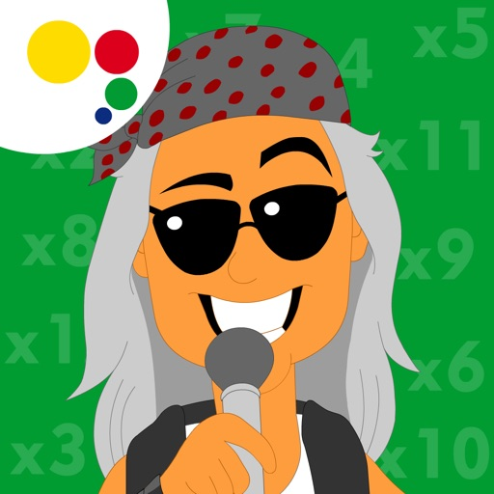
Times Tables Support
Year 4 Multiplication Check in June
TTRockstars
Hit the Button
Maths Factor
Notes:
Sandrine

Slide 11
Homework
Reading every day (5 times a week). Please sign and comment in your child’s reading record book every time they read at home. They will independently choose their reading book, based on their AR level.
Maths – Number facts and fluency.
Topic homework (fortnightly) – children will choose their activities from the grid they will be given at the start of the term.
Spellings – Five words to be sent home to reinforce learning and help to learn spelling rule
Year 5 – Grammar activity
Notes:
When is homework given? When is it returned?

Slide 12
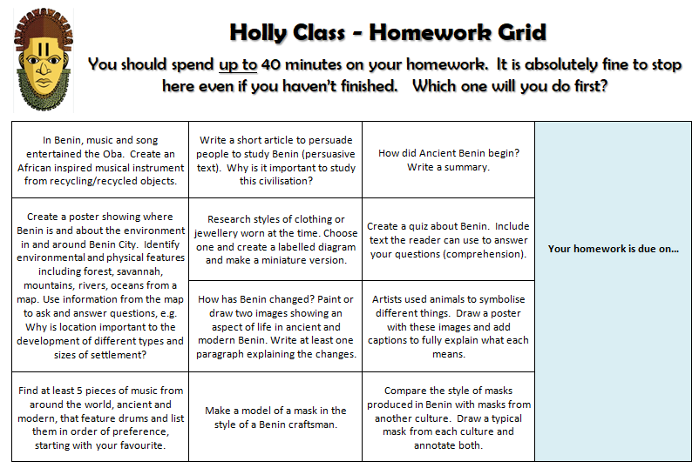
All homework to be handed in on Wednesday
Notes:
Emily

Slide 13
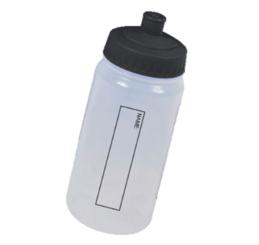
Equipment
Water Bottle (named)
Lunch box
PE kit
Reading book
No pencil case needed

Slide 14
The Mornings
Gate is open at 8:40 am
Your child will start the day with quiet reading / AR quizzing
Register is taken at 8:50 am
First lesson starts at 8:55am

Slide 15
PE
Games will take place outside. Your child should bring in jogging bottoms for the colder months to stay warm.
PE is often indoors in the winter months, then outside for athletics in the summer.
Outside | Inside
Tuesday | Thursday
Notes:
Emily

Slide 16
School Uniform
All children wear green sweatshirts embroidered with the school logo.
Trainers should not be worn to school (PE lessons and break times)
No summer sling back open toed sandals
No shoes with heels more than 1” or 2cm are permitted.
Winter shoes should be black. No boots.
Anoraks are recommended in wet weather.
Sweatshirts, polo shirts and T-shirts with the school logo may be purchased from the school.
Long hair to be tied back
Notes:
Corrine

Slide 17
Sending things in to school
Trip money – in a labelled envelope.
Birthdays – Sweets or cakes must be in individual packets. No homemade cakes please. These will be given out at the end of the day.
Notes:
Letters will be sent out reminding parents when milk and toast money is due
Parents will receive at least two weeks notice of trips
Any money sent in must be labelled and handed to TA during registration
We’re a healthy school – no sweets or cakes on birthdays. Small gifts are acceptable

Slide 18
Keeping in touch
Messages
Medical forms – must be completed
Contacts – has the office got current numbers?
Notes:
Planners are an expensive item and should be taken care of. These should be brought into school every day and returned in the evening. Staff will write in messages for parents and parents can send messages to school also. Permissions page needs to be completed. Medical forms for asthma/ any ongoing conditions must be completed. These are available from the office. Please ensure mobile/ home numbers are current.

Slide 19
Notes:
Corrine

