Slide 1


Reading Workshop
How do we teach your child to read?
What are we doing as a school?
How can you support your child in reading at home?

Slide 2

Why reading and sharing stories matters...
Reading together is fun and helps build relationships.
Books contain new words that will help build your child's language and understanding. Children learn new words as they read. Subconsciously, they absorb information on how to structure sentences and how to use words and other language features effectively in their writing and speaking.
It's the most important thing you can do to help your child succeed. Research consistently shows strong correlation between reading & academic success at all ages. Reading promotes achievement in all subjects, not just English. Children who are good readers tend to achieve better across the curriculum.
The impact lasts a lifetime. Readers are more confident and have greater job opportunities.

Slide 3

How do we teach your child to read?
Phonics and spelling rules.
Shared reading.
Individual reading.
Reading scheme linked to phonics.
Class reading book.
Class reading corners.
Sharing books with each other.
Reading time.

Slide 4
Phonics
• Phonics is taught in schools across the UK to help children learn to read.
• It teachers children to turn letters into sounds which can be blended to make words.
• There are 26 letters in the alphabet but these are used to make 44 sound (phonemes) – EYFS.
• Grapheme - how these phonemes are written – Y1/2.
• Digraph – 2 letters to make a phoneme.
• Trigraph – 3 letters to make a phoneme.
• Split Digraph – o-e, e-e, a-e
• Decode – breaking words into phonemes to read
• Blend – pushing these sounds together to read.

Slide 5

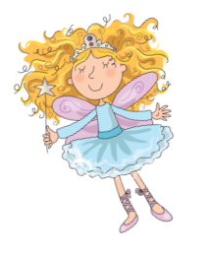
Phonics
15 minute lessons are carried out Monday to Thursday. On Friday we carry out an hour phonics lesson to consolidate the learning the children have done through the week.
We use the government validated scheme Song of Sounds to teach the children.
See song of Sounds phoneme finders for stage 1, 2, 3.

Slide 6
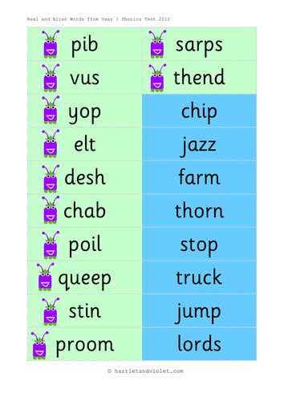
Phonics Assessment
Teachers Assess phonics throughout the year to inform which reading books from our scheme the children have.
Teachers Assess throughout the year to inform planning and work out whether extra help is needed.
Alien and Real Words.
End of Year 1 children will have a phonics screening set by the government.

Slide 7
Tricky words
Skill taught alongside phonics.
Tricky words are non-decodable words to be learnt by sight.
Fluency – reading quickly and accurately without needing to blend sounds.
https://www.youtube.com/watch?v=3QrjmYK5mTA

Slide 8
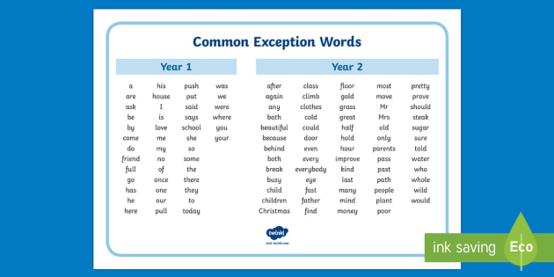

Slide 9
Comprehension
Why focus on comprehension?
• Retrieval – the answer is in the text.
• Prediction – what happens next based on what you have
already read.
• Inference - the ability to work out what the author means by clues and evidence from the text.
THERE IS NO POINT IN BEING ABLE TO DECODE IF YOU CANNOT COMPREHEND!

Slide 10
End of KS1 English reading teacher assessment frameworks.
https://www.gov.uk/guidance/teacher-assessment-exemplification-ks1-english-reading

Slide 11

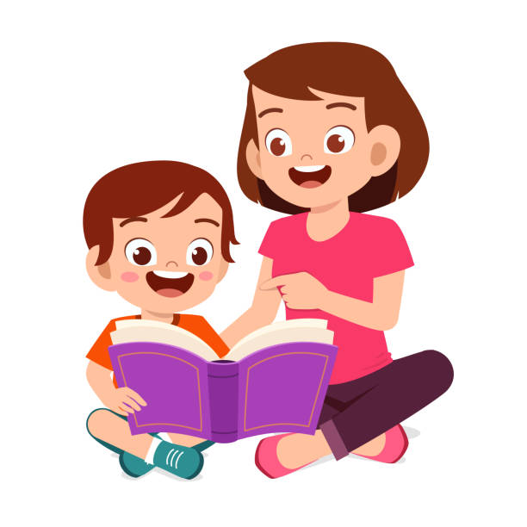
How can I support my child with reading at home?
Read every day with your child.
Reading words/phrases in your environment.
Enjoying a wide range of reading materials.
Bedtime Stories
Using libraries
Support and encouragement
Reinforcing taught phonemes/sight words
Secret messages
Matching games
Hide and seek
Phoneme spotting in books
Opportunistic i.e. recipes etc
Ask ‘good’ questions.
Be a good role model
Reading
pronunciation
Oral blending
Make reading a pleasure! Make it fun! Help your child to enjoy books!
Notes:
Record in reading diaries and read book at least three times

Slide 12


Slide 13


Why sharing stories is important.
Reading together is fun and helps build relationships.
Books contain new words that will help build your child's language and understanding.
Children learn new words as they read. Subconsciously, they absorb information on how to structure sentences and how to use words and other language features effectively in their writing and speaking.
It's the most important thing you can do to help your child succeed.
Research consistently shows strong correlation between reading & academic success at all ages. Reading promotes achievement in all subjects, not just English. Children who are good readers tend to achieve better across the curriculum.
The impact lasts a lifetime. Readers are more confident and have greater job opportunities.
Preparing today’s learners for tomorrow’s world.

